Slide 1
The business outcomes
Analyze how much time is spent per ride
Based on date and time factors such as day of week and time of day
Based on which station is the starting and / or ending station
Based on age of the rider at time of the ride
Based on whether the rider is a member or a casual rider
Analyze how much money is spent
Per month, quarter, year
Per member, based on the age of the rider at account start
EXTRA CREDIT - Analyze how much money is spent per member
Based on how many rides the rider averages per month
Based on how many minutes the rider spends on a bike per month

Slide 2
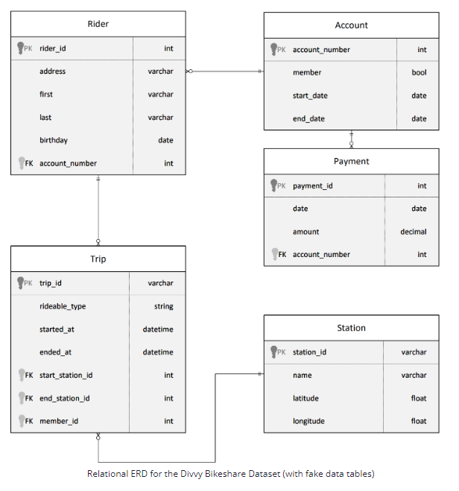

Slide 3
Star schema based on the relational diagram and the business problems
Rider_dimension
riderid | int
birthday | Date
member | bit
startdate | Date
AccountStartAge | tynyint
Payment_fact
payment_id | varchar(45)
date | date
amount | bigint
account_number | int
Calendar_dimension
Date | date
Day | tinyint
Weekday | tinyint
Year | smallint
Month | tinyint
Quarter | tinyint
Trip_fact
trip_id | varchar(50)
start_at | varchar(50)
end_at | varchar(50)
start_station_id | varchar(50)
TimeDay, | tinyint
member_id | int
Druation | int
Age_at_Time_of _Trip | tinyint
Station_dimension
stationid | varchar(50)
name | varchar(100)

Slide 4
Analyze how much time is spent per ride
Based on date and time factors such as day of week and time of day
Based on which station is the starting and / or ending station
Based on age of the rider at time of the ride
Based on whether the rider is a member or a casual rider
Rider_dimension
riderid | int
birthday | Date
member | bit
startdate | Date
AccountStartAge | tynyint
Calendar_dimension
Date | date
Day | tinyint
Weekday | tinyint
Year | smallint
Month | tinyint
Quarter | tinyint
Trip_fact
trip_id | varchar(50)
start_at | varchar(50)
end_at | varchar(50)
start_station_id | varchar(50)
TimeDay, | tinyint
member_id | int
Druation | int
Age_at_Time_of _Trip | tinyint
Station_dimension
stationid | varchar(50)
name | varchar(100)

Slide 5
Analyze how much money is spent
Per month, quarter, year
Per member, based on the age of the rider at account start
Rider_dimension
riderid | int
birthday | Date
member | bit
startdate | Date
AccountStartAge | tynyint
Payment_fact
payment_id | varchar(45)
date | date
amount | bigint
account_number | int
Calendar_dimension
Date | date
Day | tinyint
Weekday | tinyint
Year | smallint
Month | tinyint
Quarter | tinyint

Slide 6
EXTRA CREDIT - Analyze how much money is spent per member
Based on how many rides the rider averages per month
Based on how many minutes the rider spends on a bike per month
Calendar_dimension
Date | date
Day | tinyint
Weekday | tinyint
Year | smallint
Month | tinyint
Quarter | tinyint
Trip_fact
trip_id | varchar(50)
start_at | varchar(50)
end_at | varchar(50)
start_station_id | varchar(50)
TimeDay, | tinyint
member_id | int
Druation | int
Age_at_Time_of _Trip | tinyint
Payment_fact
payment_id | nvarchar(4000)
date | nvarchar(4000)
amount | nvarchar(4000)
account_number | nvarchar(4000)
member_behavior
member_id
CountTripPerMonth
SpentTimePerMonth

Slide 7
EXTRA CREDIT - Analyze how much money is spent per member
Based on how many rides the rider averages per month
Based on how many minutes the rider spends on a bike per month
Trip_fact
trip_id | nvarchar(4000)
start_at | nvarchar(4000)
end_at | nvarchar(4000)
start_station_id | nvarchar(4000)
TimeDay, | nvarchar(4000)
member_id | bigint
Druation | TINYINT
Age_at_Time_of _Trip | TINYINT
Calendar_dimension
Date | Date
Day of week | TINYINT
Year | Year
Month | CHAR(6)
Quarter | CHAR(6)
Payment_fact
payment_id | varchar(45)
date | date
amount | bigint
account_number | int
member_behavior
member_id
CountTripPerMonth
SpentTimePerMonth

